Slide 1



BookMart
School Supplies -E-Commerce
A modern e-commerce platform for buying school supplies and stationery.
Built with: React 19 • Vite •Bootstrap 5
Team Leader : Mahmoud Fathy Samir
Team Members:
Abdelrahman Mohamed Ibrahim
Omar Abdelraouf Ahmed
Seif Eldin Mostafa Mahdy Mohamed

Slide 2




What is BookMart?
Easy Browsing & Search
Browse products by category with fast search and filtering to find exactly what you need.
Simple Shopping Experience
A smooth shopping journey with cart, favorites, and product management tools for Admins.
English & Arabic Support
Full bilingual support with RTL layout for Arabic, making the platform accessible to all users.
Product management for Admins

Slide 3






Key Features
Shopping: Products & Categories, Search & Filtering, Cart & Favorites, Sale Prices
User Roles: Guest, Customer, and Admin with dedicated permissions
Language Support: English & Arabic with full RTL layout support
UI Experience: Dark/Light Mode and fully Responsive Design

Slide 4




Admin Management
Admins manage the store through a dedicated dashboard with full CRUD operations — Add, Edit, and Delete products, and manage inventory with ease.
View store statistics, control all product listings, and oversee categories and stock levels from one centralized admin panel.

Slide 5




Guest vs Customer
BookMart Platform
Guest
Browse products
Search & filter
View product details
Register / Login
Customer
All Guest features
Add products to Cart
Manage Favorites
Manage Profile
Persistent login session
Access Control
Guest → Public Pages
Customer → Public + Protected Pages

Slide 6


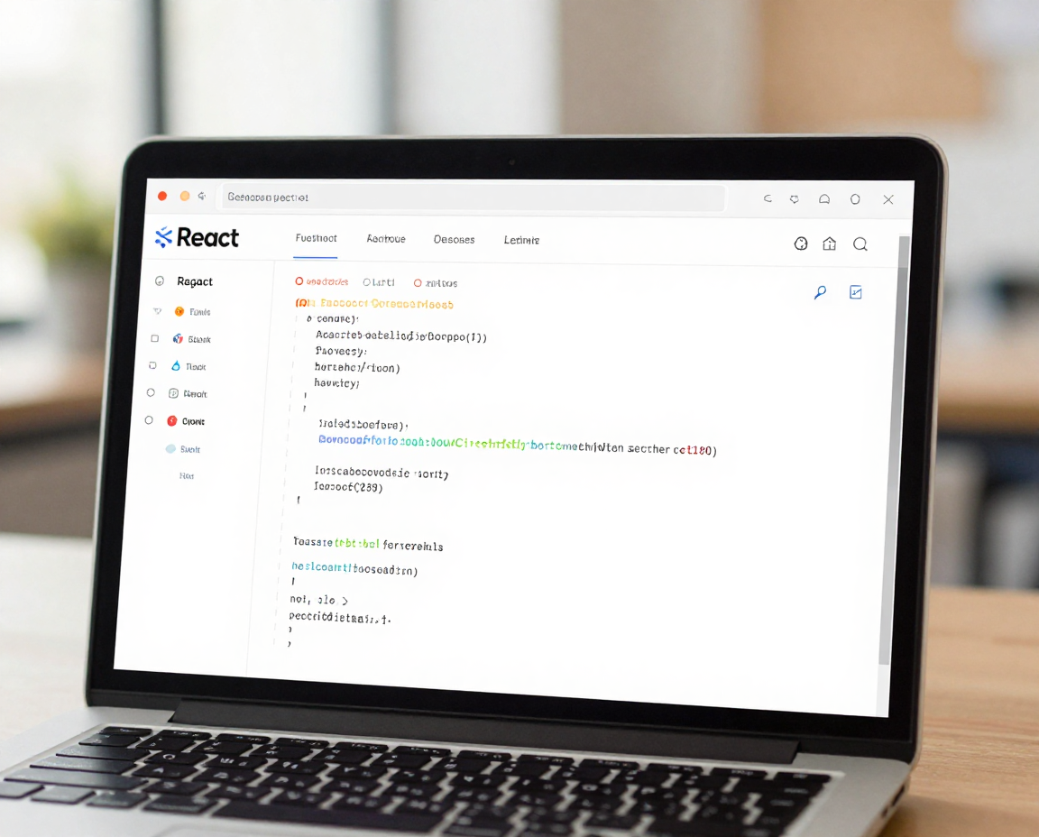

Technology Stack
React 19 + Vite + Bootstrap 5
React Router + Context API
LocalStorage + JSON Data
React UI → API Service → Local Database

Slide 7







Thank You!
BookMart
Questions?
School Supplies E-Commerce Platform

